Slide 1


Enter Navicat And Connect To
MySQL Databases
Navicat Certified Database Administrator - Associate

Slide 2

HKIIT - Navicat Certified Database Administrator - Associate
2
Lessons Intended Learning Outcome
On completion of this lesson, students are expected to be able to:
Install and configure Navicat Premium for managing databases on Windows.
Establish secure connections to MySQL databases using Navicat, including SSH and HTTP tunneling.
Handle common connection errors encountered during the setup and use of Navicat with MySQL databases.

Slide 3
HKIIT - Navicat Certified Database Administrator - Associate
Learning Outline
Introduction to database GUI tool - Navicat
Installation and Setting up Navicat and MySQL server
Configuring connection profiles for MySQL databases in Navicat.
Understanding secure connection methods (SSH, HTTP tunneling).
Troubleshooting common connection errors.
Manage connection profiles in Navicat.

Slide 4
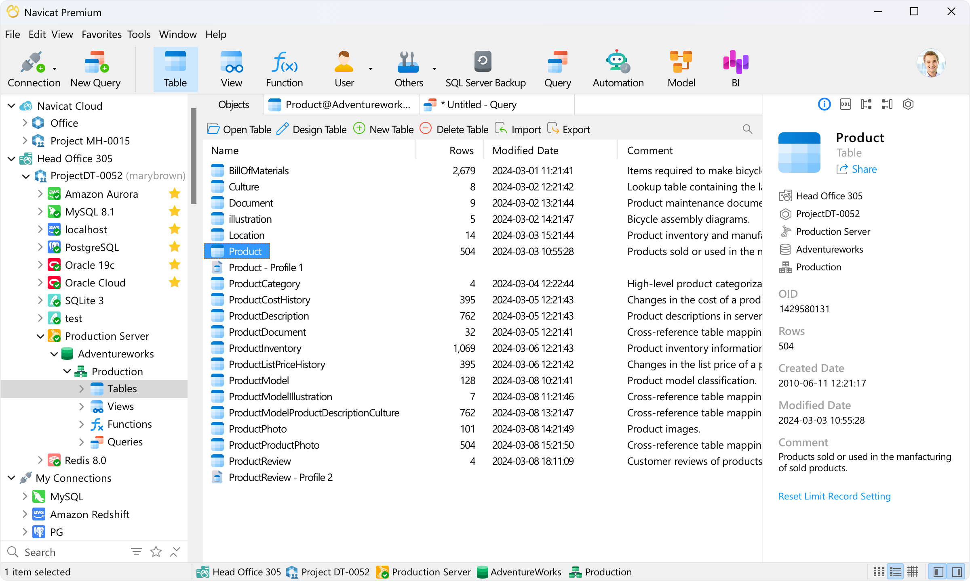
HKIIT - Navicat Certified Database Administrator - Associate
Enter Navicat
Navicat is a powerful, user-friendly database administration tool.
Intuitive graphical user interface (GUI)
Simplifies database management
Write complex query
Manage database objects
Data migration
Backup and Restore Solution
Multiple Platform Support
Windows
macOS
Linux

Slide 5
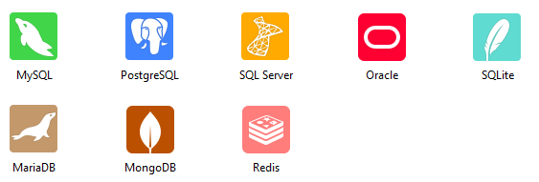
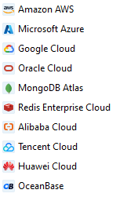
HKIIT - Navicat Certified Database Administrator - Associate
Navicat
Support to connect to Popular database systems and Cloud Databases

Slide 6






HKIIT - Navicat Certified Database Administrator - Associate
Navicat Users & Clients
A comprehensive suite of tools to meet diverse user needs.
Developer
Database
Administrator
Database
Beginner

Slide 7
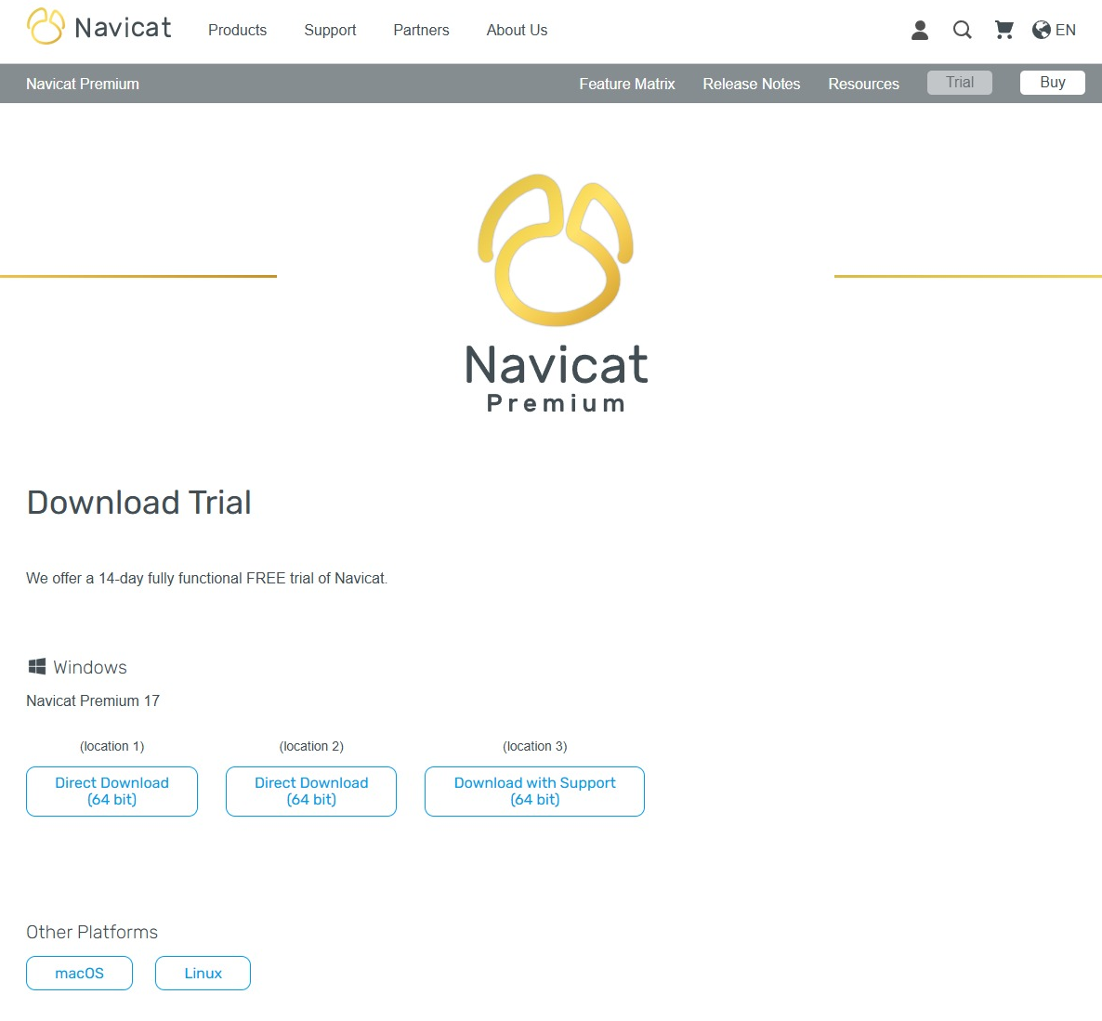
INSTALLATION
Install
Navicat Premium
Official download page
https://www.navicat.com/en/download/navicat-premium

Slide 8
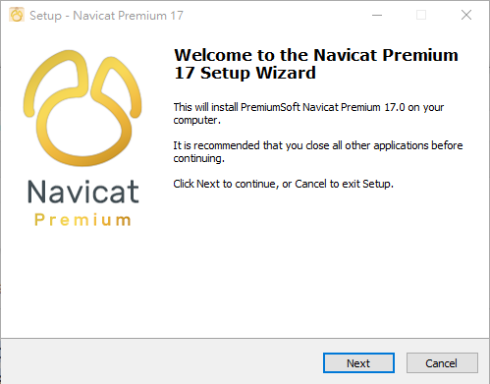
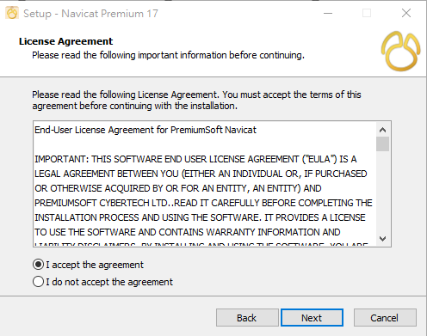
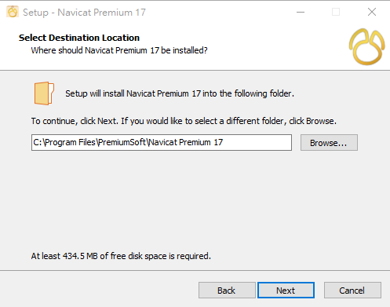
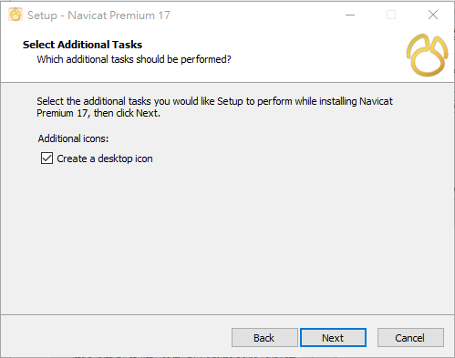
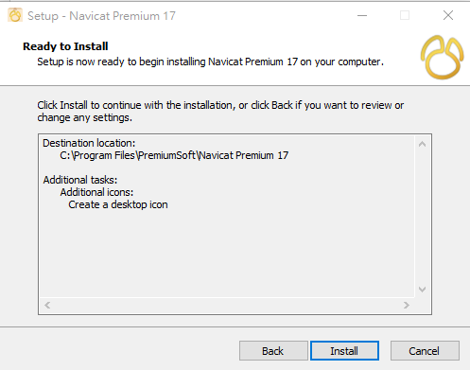
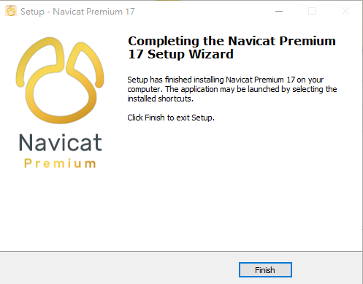
INSTALLATION
01
02
03
04
05
06

Slide 9
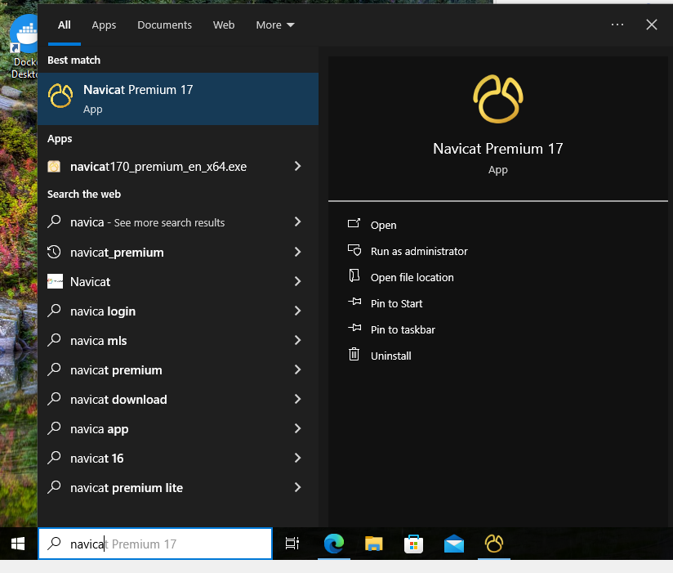

INSTALLATION
Access to Navicat
After successful installation, you can find the installed Navicat Premium in the Start menu.
1. Enter Navicat in the search bar.
HKIIT - Navicat Certified Database Administrator - Associate

Slide 10
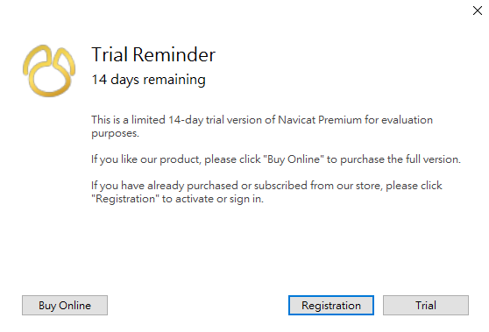
SETUP
Navicat Premium Activation
Click Trial and get the free 14 days fully functional trial of Navicat Premium
Try the latest features in Navicat 17
Navicat Premium Price Plan | Navicat Store
HKIIT - Navicat Certified Database Administrator - Associate

Slide 11
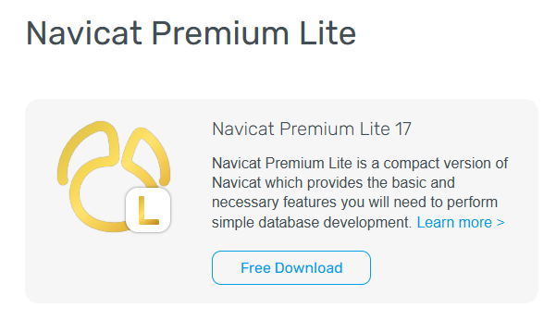
INFO
Navicat Premium Lite
A Free Edition of Navicat
Free for Commercial and Non-Commercial Use
Each organization can use up to 5 free Navicat Premium Lite user accounts at any time.
Navicat Premium Lite | Simple Database Management & Development Tool
HKIIT - Navicat Certified Database Administrator - Associate

Slide 12
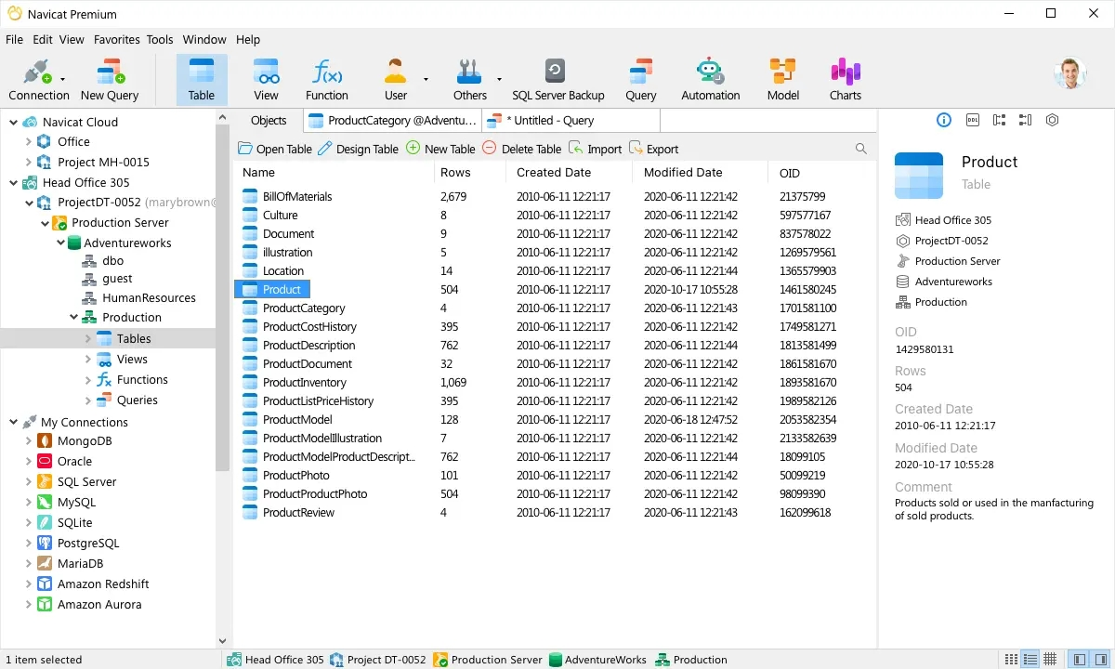
Navicat
Main Screen
HKIIT - Navicat Certified Database Administrator - Associate

Slide 13
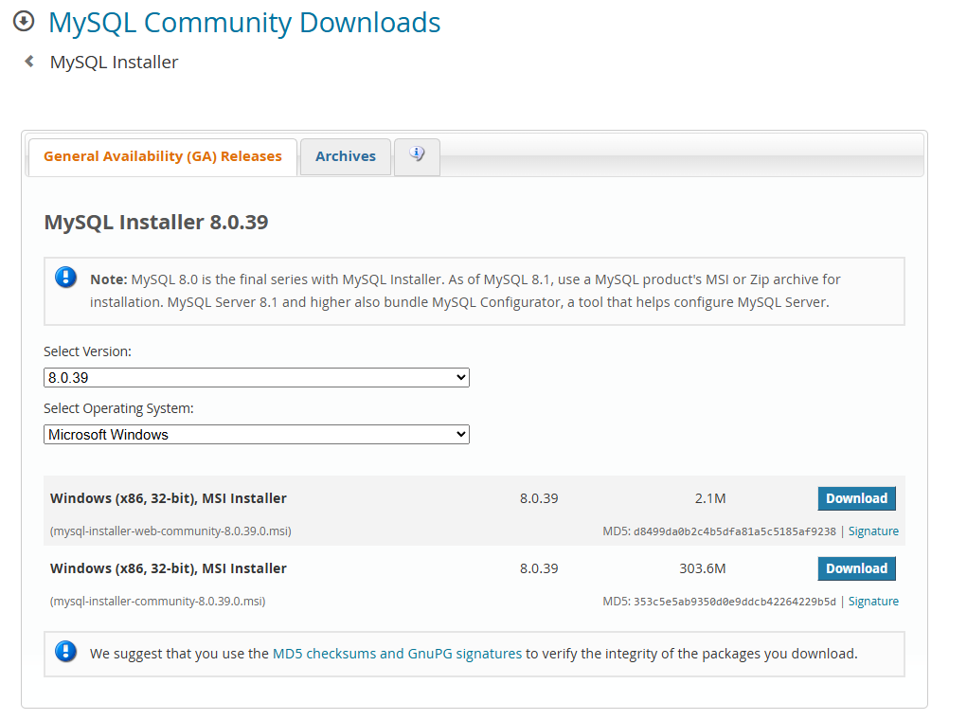
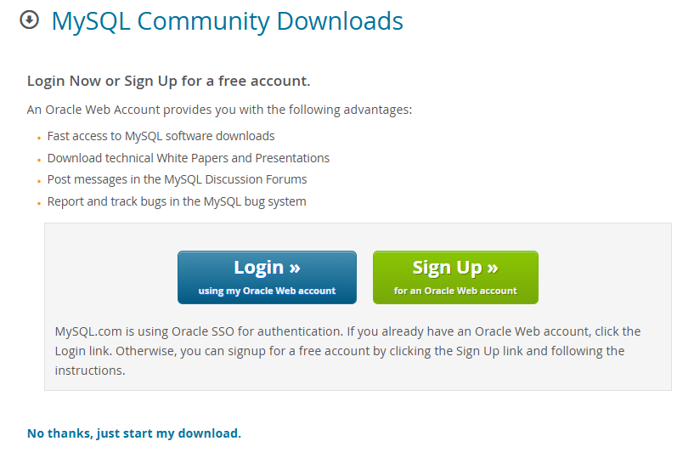
INSTALLATION
INSTALLATION
MySQL 8.0
Download MySQL Installer
https://dev.mysql.com/downloads/installer/
HKIIT - Navicat Certified Database Administrator - Associate

Slide 14
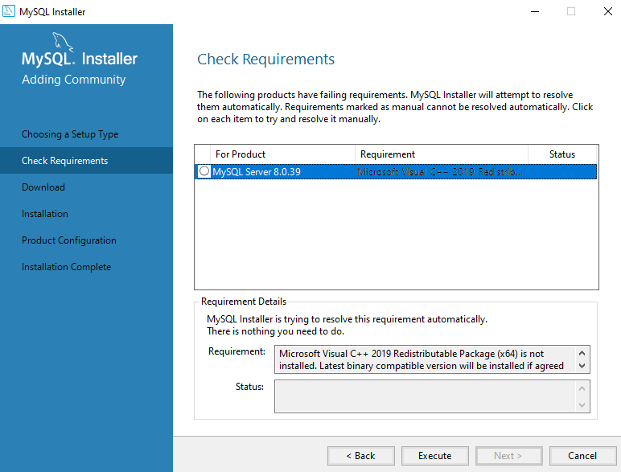
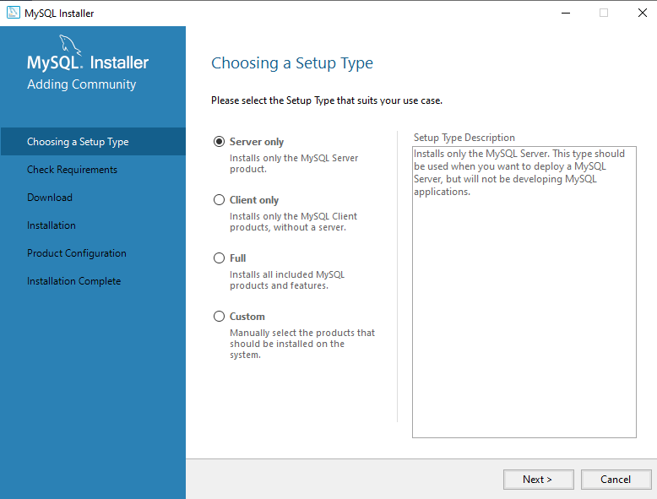
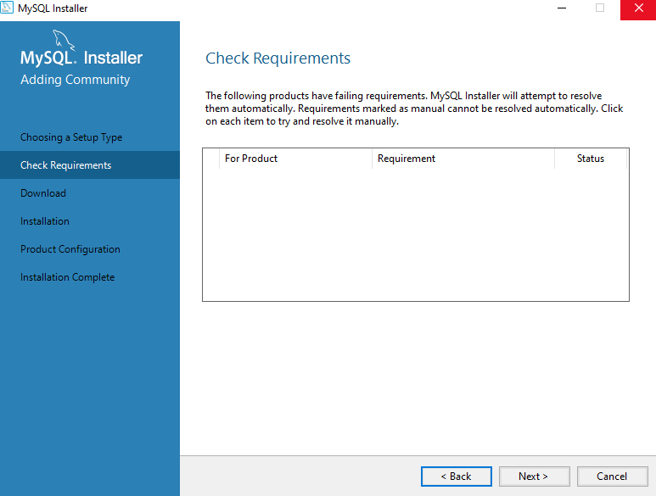
INSTALLATION
MySQL 8.0
HKIIT - Navicat Certified Database Administrator - Associate

Slide 15
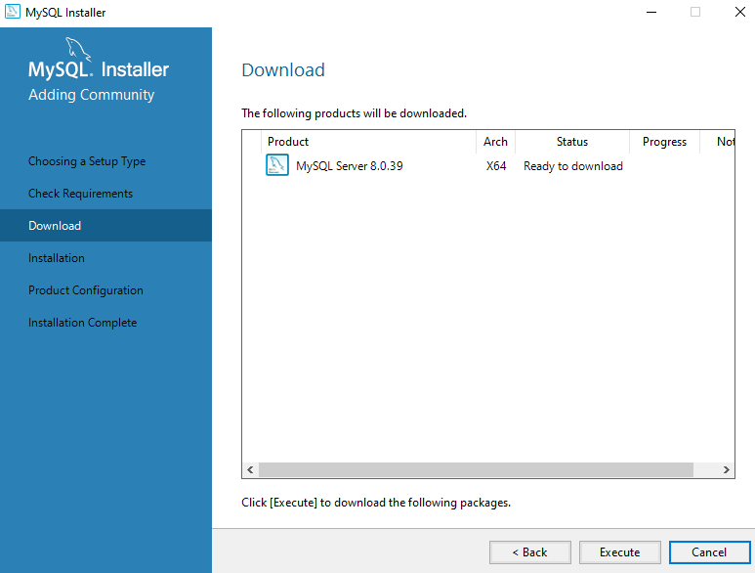
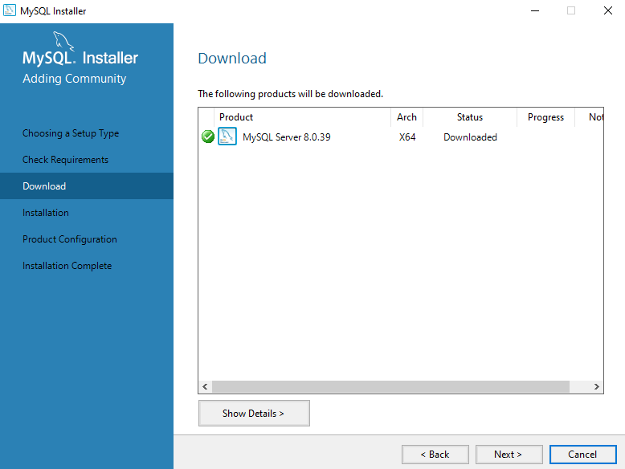
INSTALLATION
MySQL 8.0
HKIIT - Navicat Certified Database Administrator - Associate

Slide 16


INSTALLATION
MySQL 8.0
HKIIT - Navicat Certified Database Administrator - Associate

Slide 17
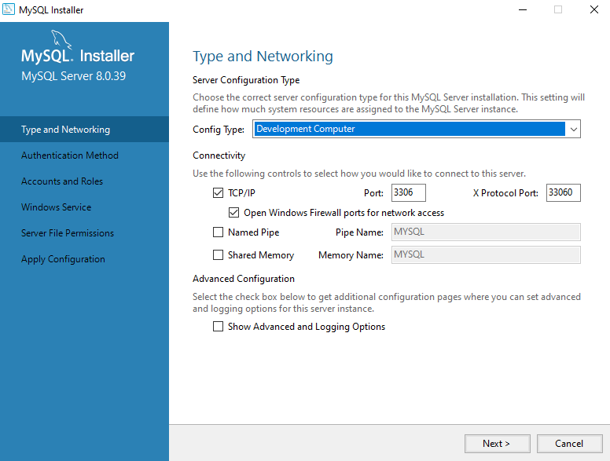
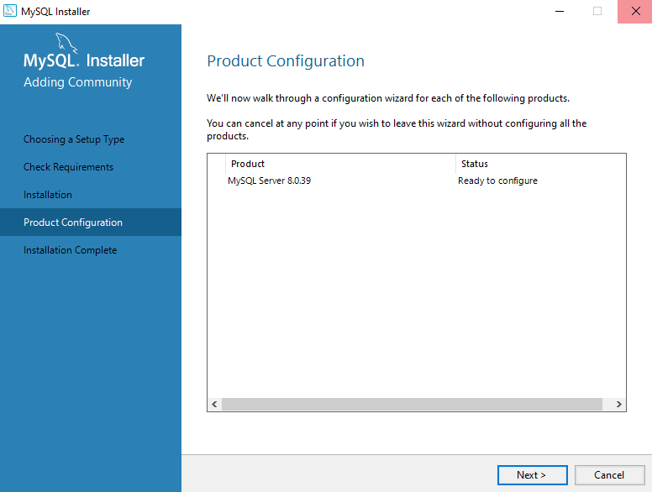
INSTALLATION
MySQL 8.0
HKIIT - Navicat Certified Database Administrator - Associate

Slide 18
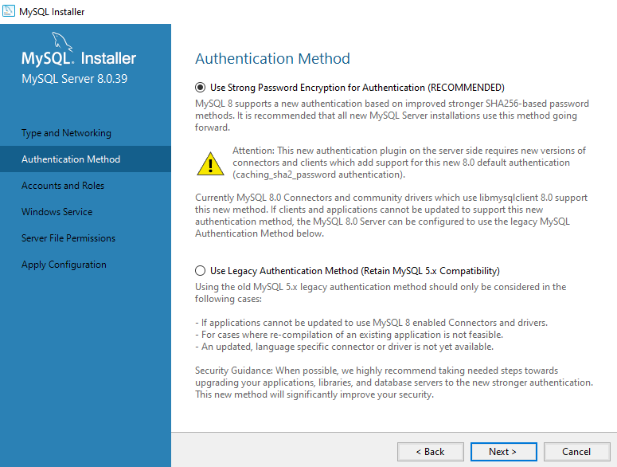
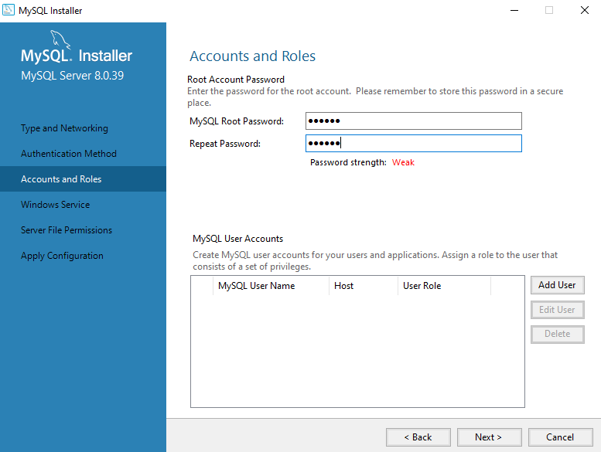
INSTALLATION
MySQL 8.0
HKIIT - Navicat Certified Database Administrator - Associate

Slide 19
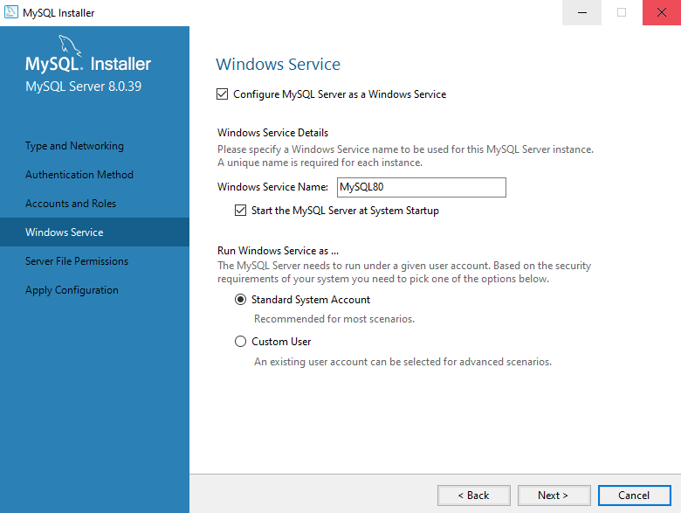
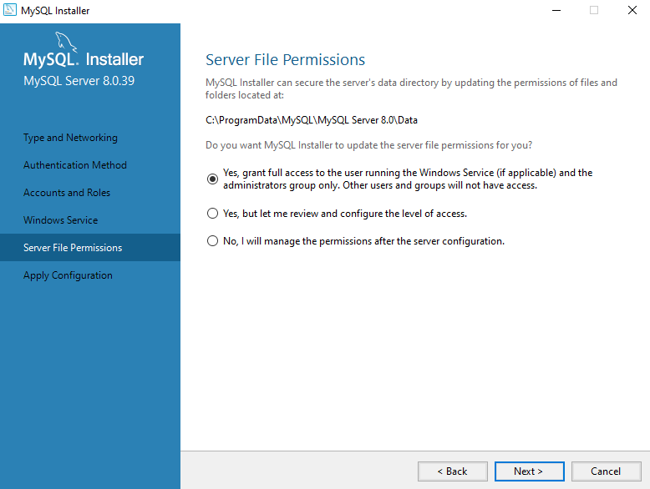
INSTALLATION
MySQL 8.0
HKIIT - Navicat Certified Database Administrator - Associate

Slide 20
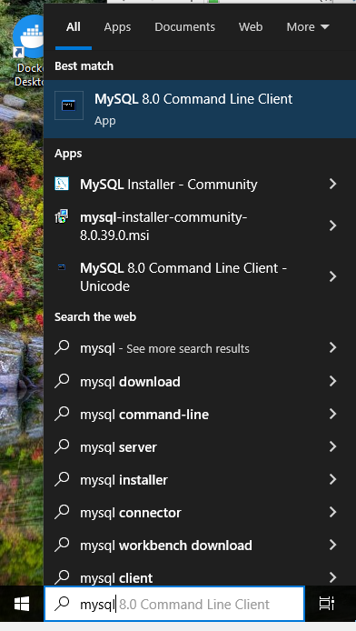
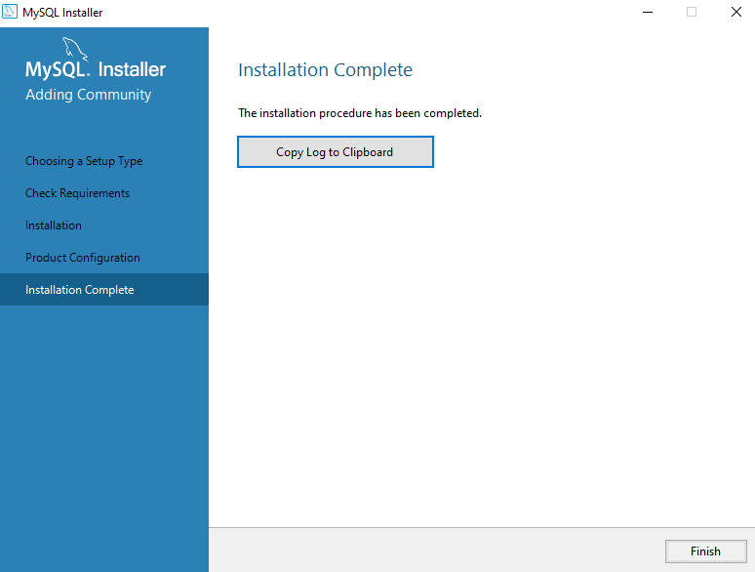
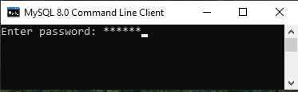
INSTALLATION
MySQL 8.0
HKIIT - Navicat Certified Database Administrator - Associate

Slide 21
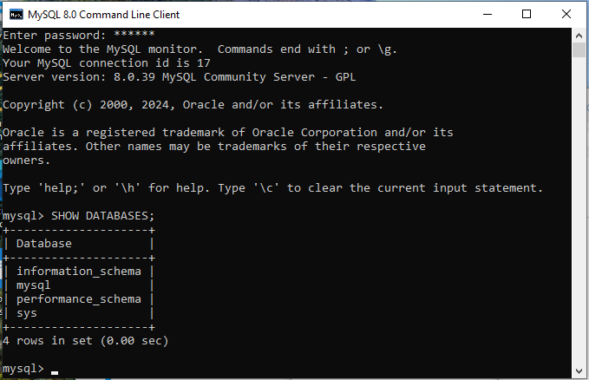
MySQL Commands
SHOW DATABASES;
Command to get list of databases on the MySQL server host.
HKIIT - Navicat Certified Database Administrator - Associate

Slide 22
MySQL Commands
information_schema
provides access to database metadata, information about the MySQL server such as the name of a database or table, the data type of a column, or access privileges.
HKIIT - Navicat Certified Database Administrator - Associate

Slide 23
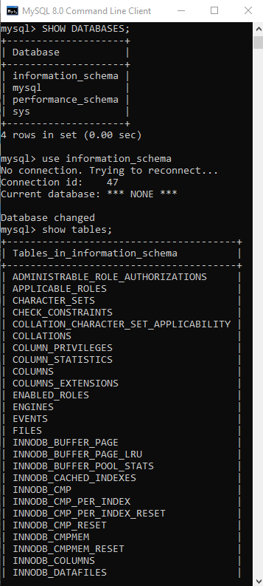
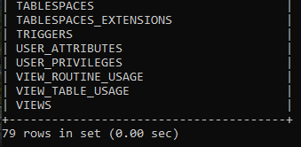
MySQL Commands
use db_name;
Tell MySQL to use the db_name database as the default (current) database for subsequent statements.
Show tables;
List the tables within a specific database
The tables are ordered in alphabetical order.
The summary line tells us how many rows (or tables) are there in the database.
HKIIT - Navicat Certified Database Administrator - Associate

Slide 24
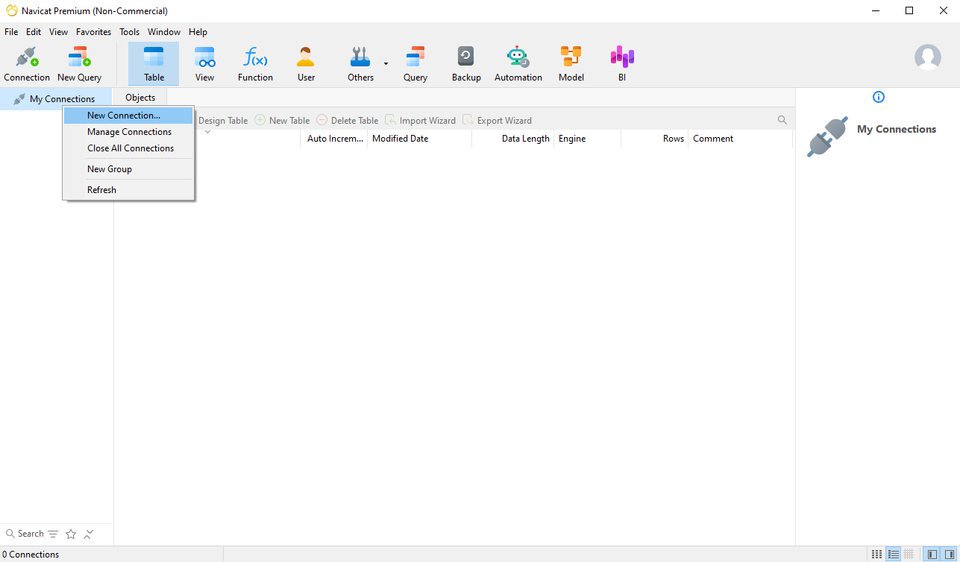
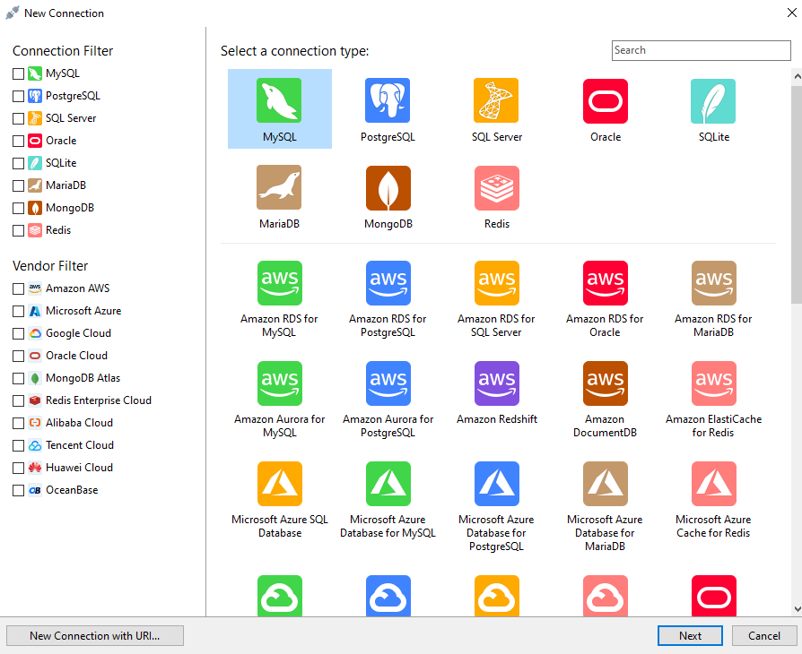
CONNECTING
Creating Connection Profile
1.Right Click My Connections
2.Click New Connection
3. Double Click ‘MySQL’
HKIIT - Navicat Certified Database Administrator - Associate

Slide 25
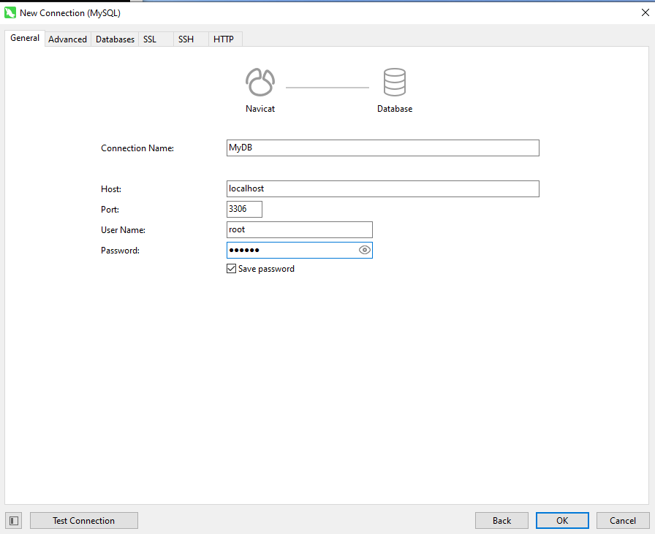
CONNECTING
Config Connection Profile
Enter your Database Connection credentials.
Connection Name: Any name to describe your connection.
Host: Enter the domain name of your database server or its IP address.
Port: The TCP/IP port number of the MySQL server which in most cases is 3369
HKIIT - Navicat Certified Database Administrator - Associate

Slide 26
CONNECTING
Config Connection Profile
User Name: The database username
Password: Password for the above entered username.
HKIIT - Navicat Certified Database Administrator - Associate

Slide 27
CONNECTING
Connecting to MySQL server
1. Click Test Connection.
You should get a connection successful message with MySQL version.
2. Click Ok to accept the Connection Settings.
HKIIT - Navicat Certified Database Administrator - Associate

Slide 28
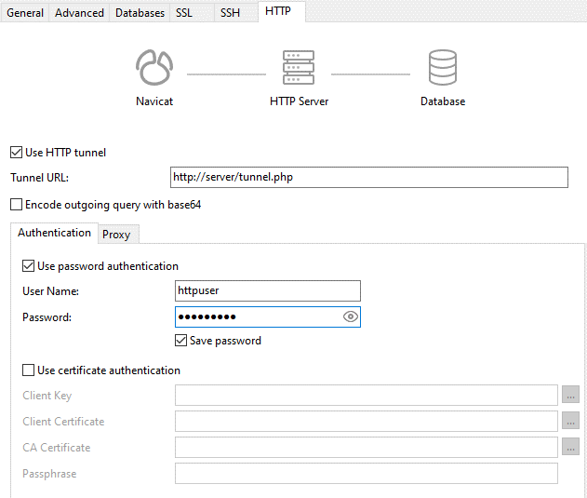
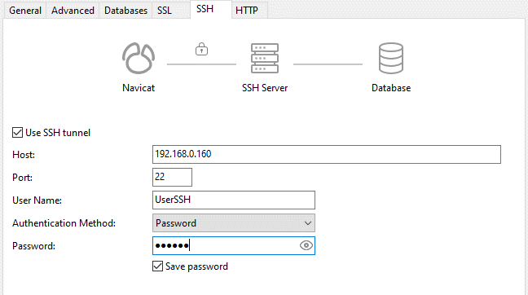
CONNECTING
Secure Connections with SSH / HTTP Tunnels
HKIIT - Navicat Certified Database Administrator - Associate

Slide 29
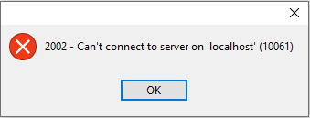
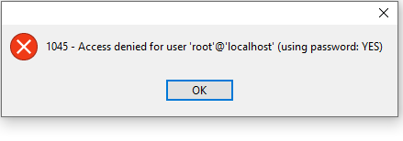
CONNECTING
Common Connection Errors
Check that the hostname and port are correct.
Check network policies and firewall rules
Check the MySQL server status
Check that the user name and password are correct.
Check that access privileges are granted for the username
Reset the password
HKIIT - Navicat Certified Database Administrator - Associate

Slide 30
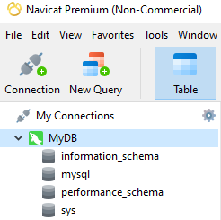
CONNECTING
Connecting to MySQL DataBase
The Database connection will show in the left pane listing the names of the database.
HKIIT - Navicat Certified Database Administrator - Associate

Slide 31
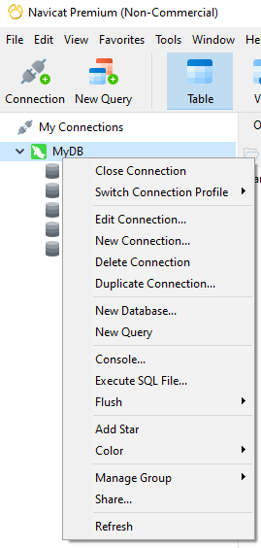
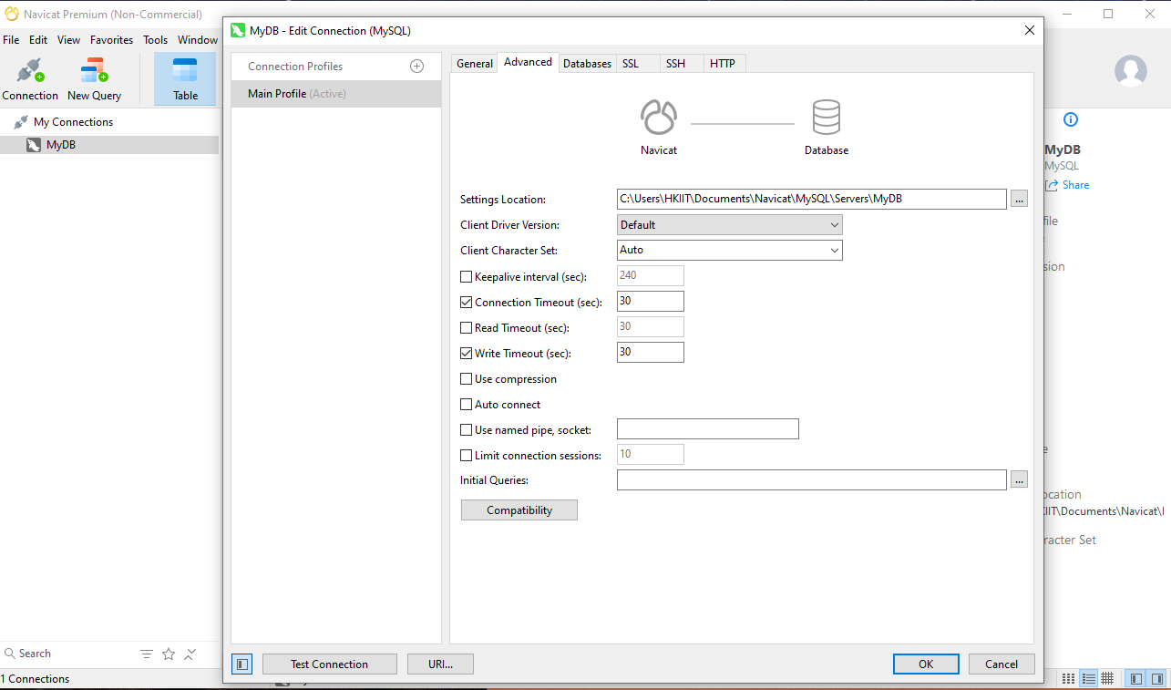
CONNECTING
Manage Connection Profile
Right click to show the Contextual pop-up menu
HKIIT - Navicat Certified Database Administrator - Associate

Slide 32
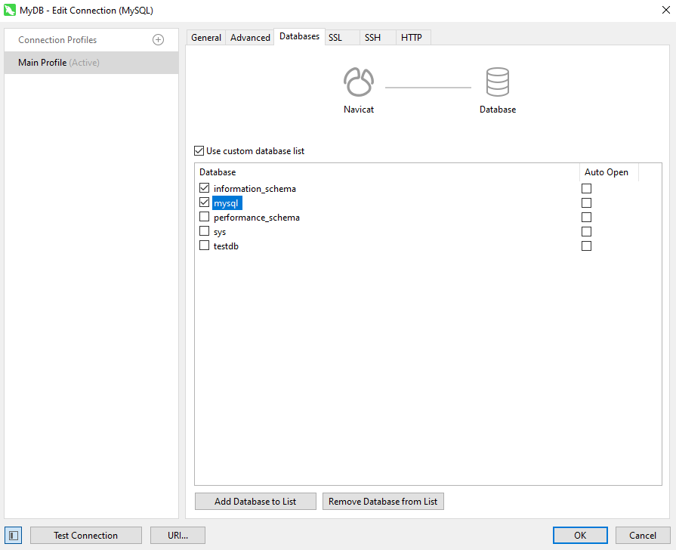
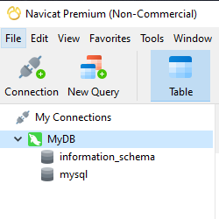
CONNECTING
Hide and Show Certain Databases
On the Databases tab, we'll deselect all but a few core databases:
HKIIT - Navicat Certified Database Administrator - Associate

Slide 33
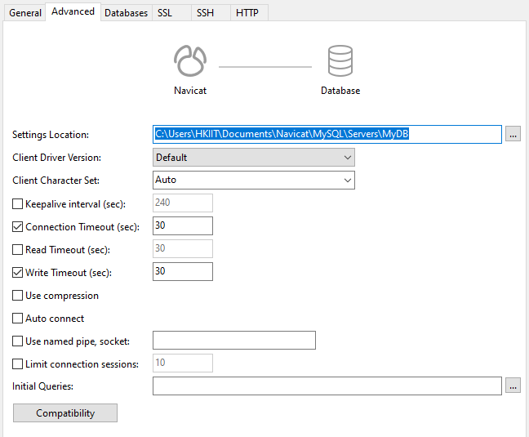
CONNECTING
Advanced Setting
An option for setting advanced database properties
The first field labeled, Setting Save Path, allows you to save your settings at a location of your local drive, which you specify.
You can tweak some other settings, such as overriding the character encoding, pinging intervals to the database server, auto-connections, using sockets file, that is, mysql . sock, and so on.
HKIIT - Navicat Certified Database Administrator - Associate

Slide 34

Navicat
Connect to MySQL Server
We established the foundation for the courses by learning how to connect Navicat to a MySQL server using various methods, including basic parameters and secure configurations like SSH and HTTP tunneling for limited internet access.
HKIIT - Navicat Certified Database Administrator - Associate

